Slide 1
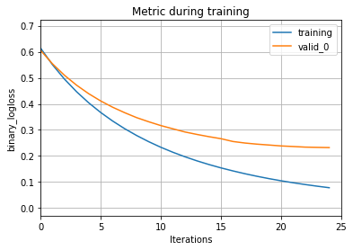
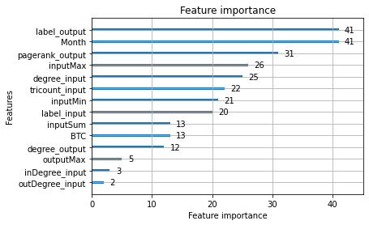

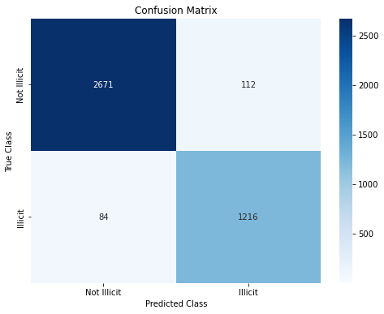

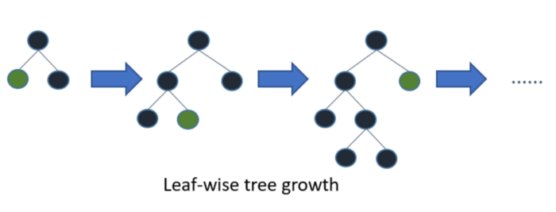
Illicit Transactions Prediction on a Blockchain Network
 | Month | Day | Time | DayOfWeek | TransactionID | InputAddress | OutAddress | BTC | Illicit
0 | 4 | 27 | 12:38:19 | 6 | 4b585ab8815f189d1 | 19WNHovTv17jAih | 1VayNert3x1KzbpzMG | 50 | 0
MODEL PREFORMANCE
Wallet 1
GRAPH ANALYTICS
Transfer To
Community Detection
Transaction Triangle Counts
Clustering Wallets
Number of Incoming Transactions
Number of Outgoing Transactions
Total Number of transactions (both outgoing and incoming)
Wallet Importance Ranking - PageRank (Google Search Algorithm)
Degrees of separation to illicit nodes
Wallet 2
Wallet 3
Wallet 4
Wallet 5
Wallet 5
94%
Accurately Predicted Illicit Transactions
2796 licit
1300 illicit
Transactions in Dataset
LEAF-WISE TREE GROWTH
97%
Accurately Predicted licit Transactions
95%
Overall prediction accuracy

